Slide 1
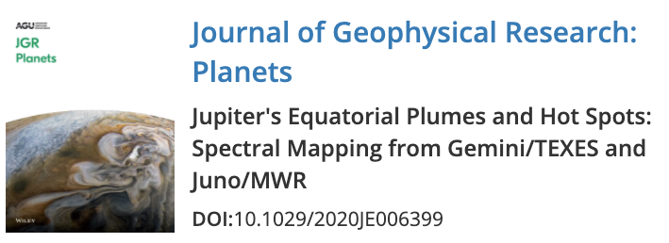
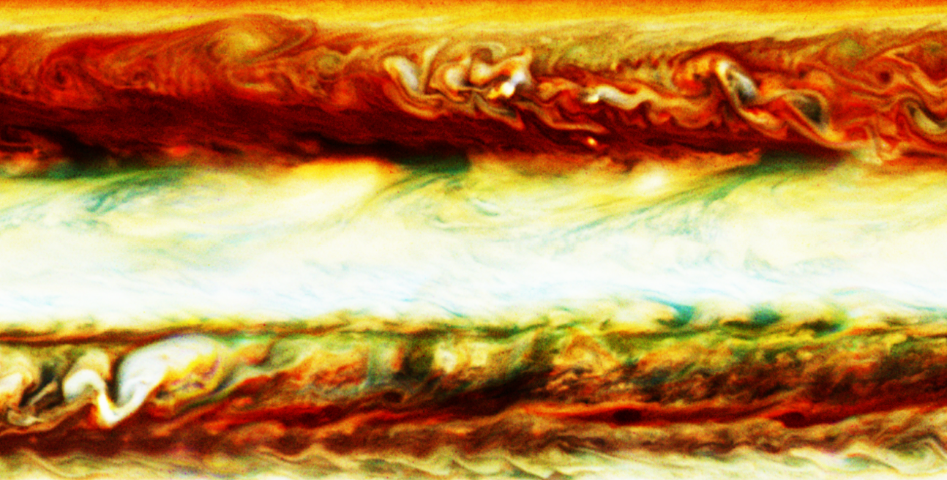
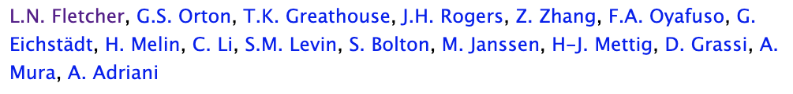


Slide 2
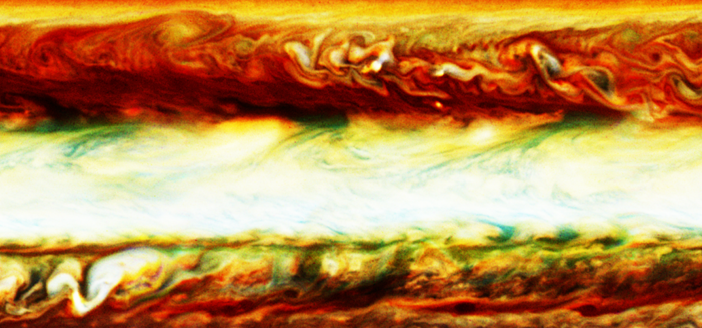
Jupiter’s Equatorial Zone
Hubble WFC3 2017-04-03
Credit to OPAL Team!
NEBn
Hotspot
NEBs
Plume
Gyre
Festoon
SEBn
SEBs

Slide 3
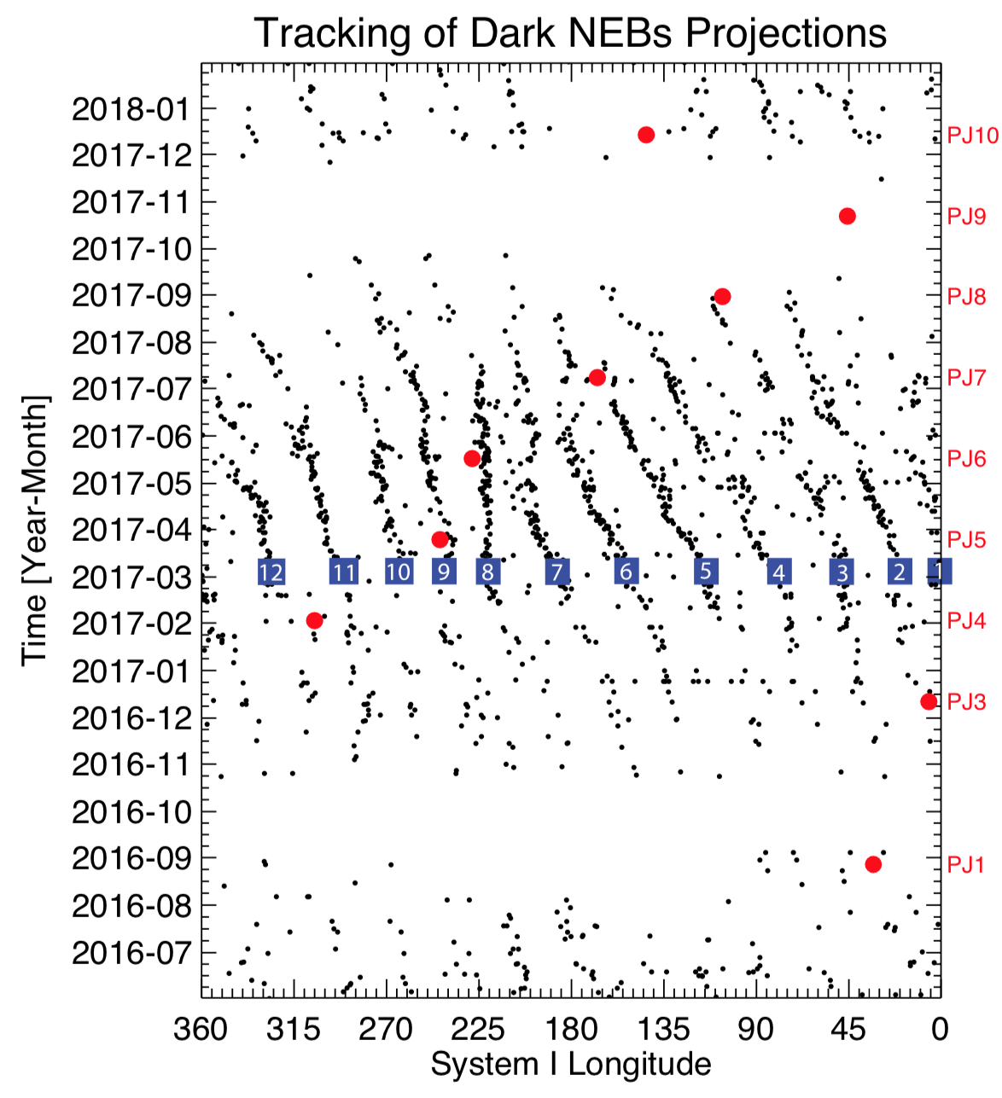
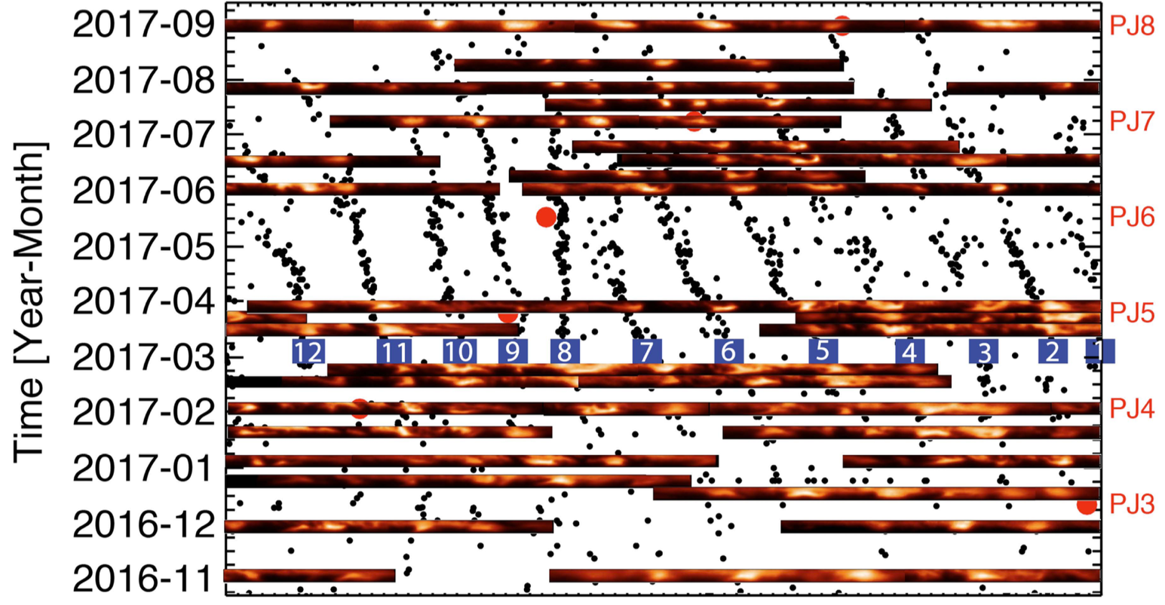
Tracking Hotspots & Gyres
NEBs features move ~113.9 m/s (10,000 km/day).
Longitude “System I” used for features ±7º of equator.
WinJupos (jupos.org) used to trace hotspot locations, but not precise enough.
5-µm brightness confirmed by Orton et al. SpeX programme.

Slide 4
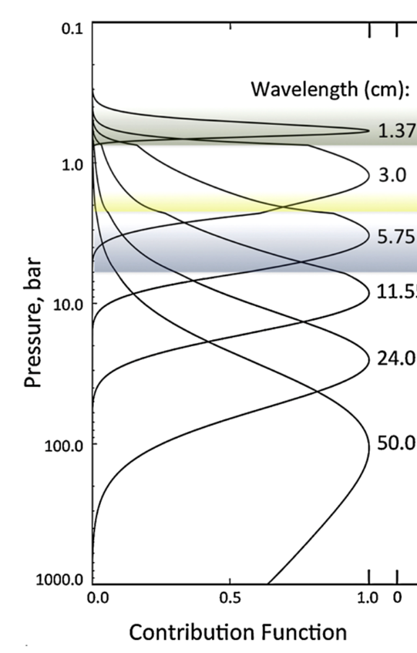
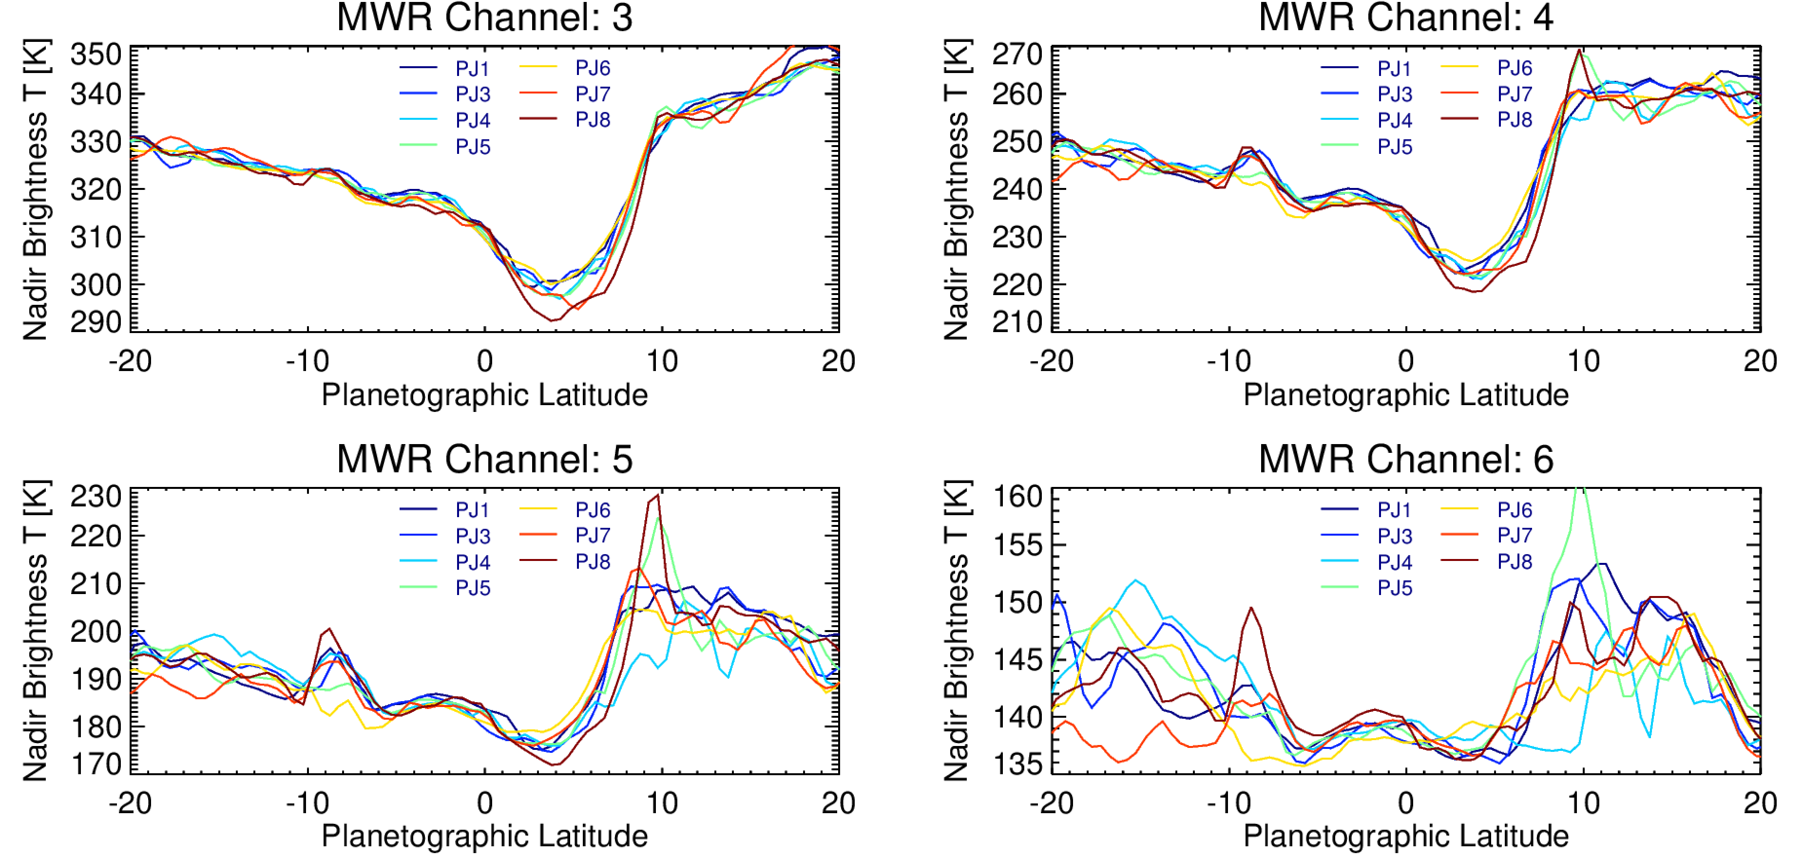
Significant Variability Observed by Juno/MWR
11.5 cm
5.75 cm
3.0 cm
1.37 cm
Is this variability due to ammonia? Temperature?
What are we looking at here?
Nadir brightness temperatures along PJ passes – variability im Ch4-6 (p<5-8 bar).
Notes:
We’re seeing contrasts of around 30K in channel 5 and 20K in channel 6… indicative of hotspots, but not quite?
These are raw antenna temperatures in the 1.4-11cm range, showing the degree of variability over the first 7 PJs. You can see the persistent low brightness temperature (interpreted as being due to enhanced NH3) at 3-5N, but also the large variability in the 5-9 N range due to the presence of the hotspot.
Is it possible that the hotspots aren’t as bright at the 265K estimate of Orton 1998?
Ortiz et al. 276 K.
Suggests NIMS was even higher - and none of the MWR footprints have seen that yet.
What’s the contrast seen by NIMS?
No variability seen by Channel 3?

Slide 5
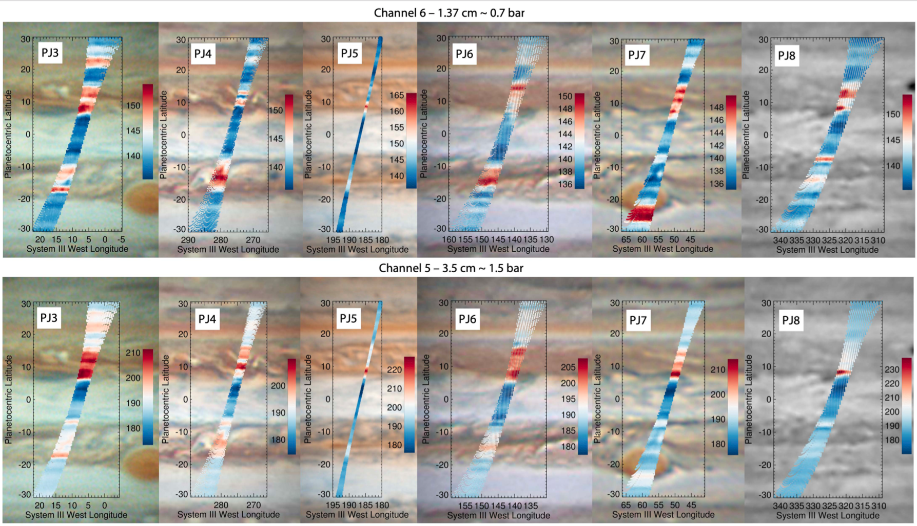

Slide 6
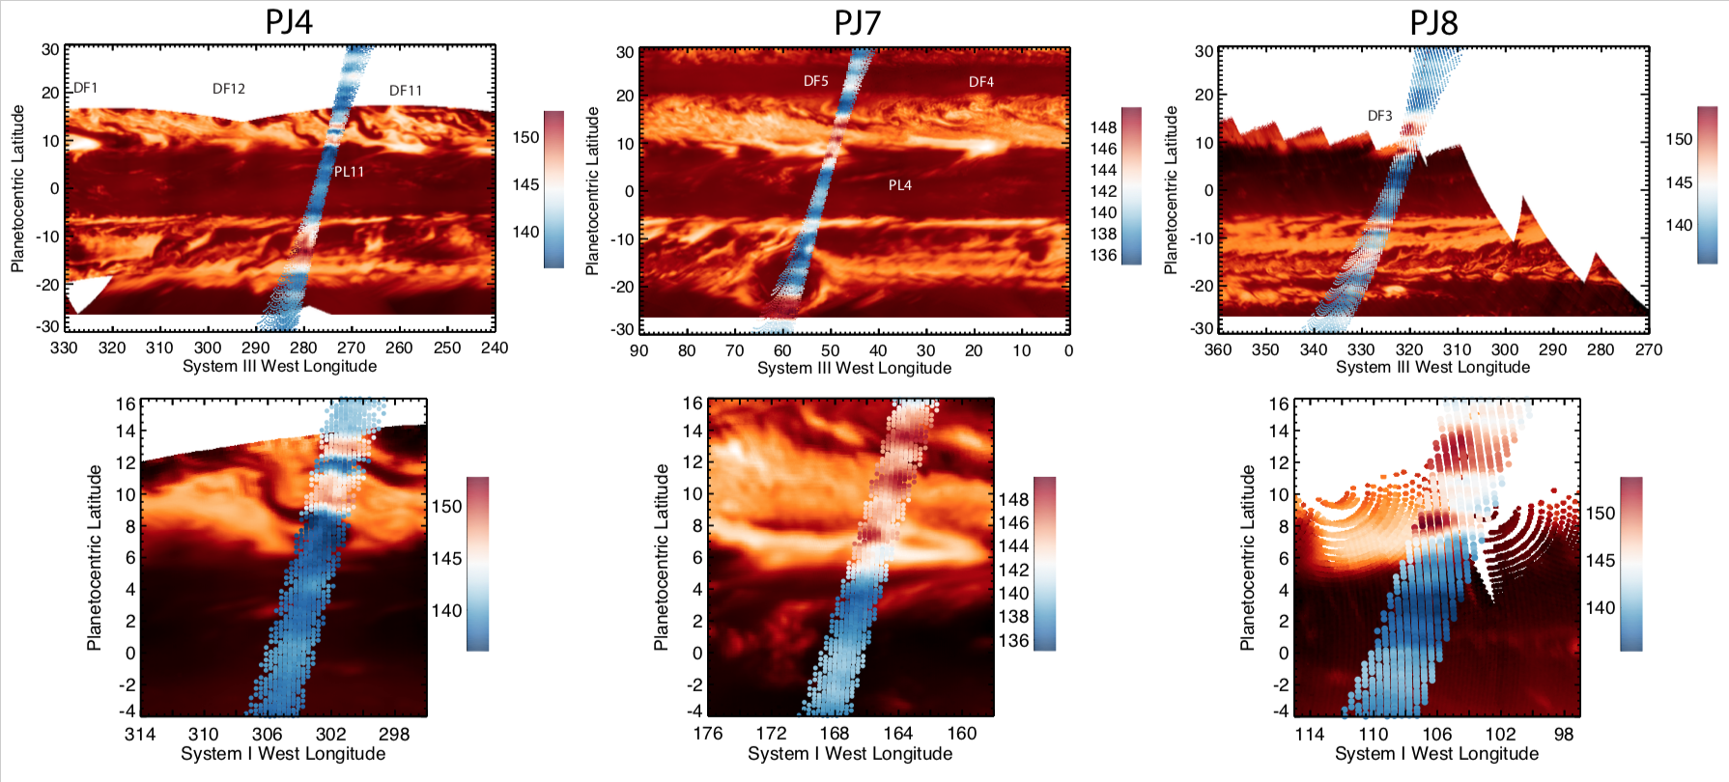
Cross-Comparison with JIRAM
Aerosols are not a good proxy for MWR-brightness.

Slide 7
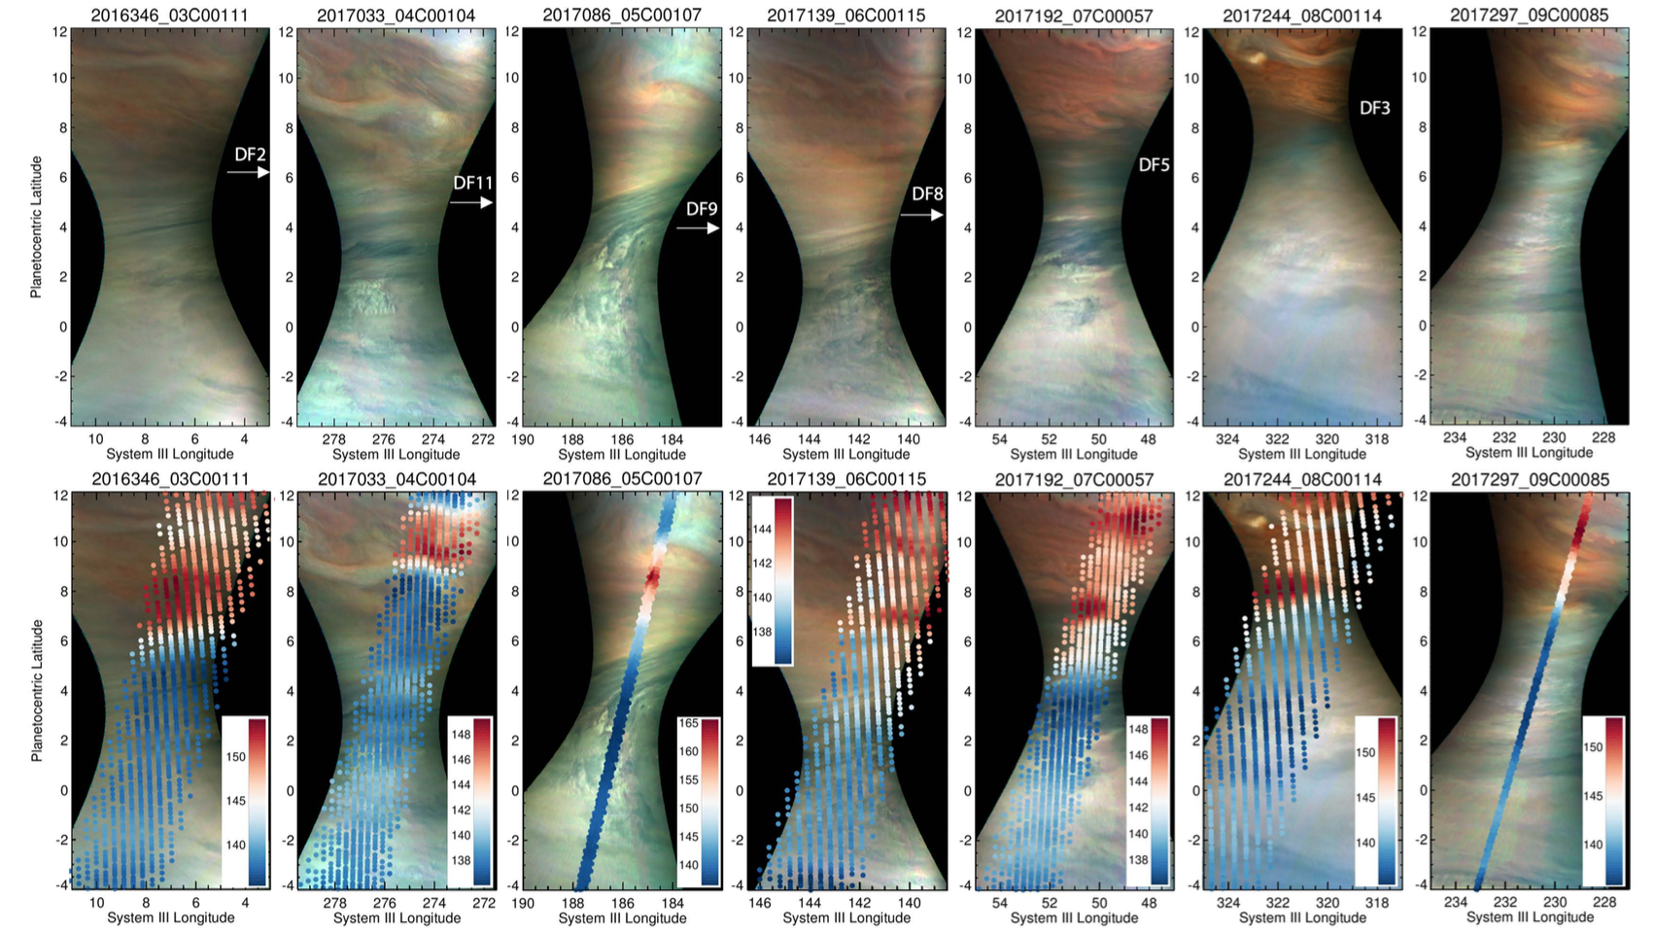
Cross-Comparison with JunoCam
Aerosols are not a good proxy for MWR-brightness.

Slide 8
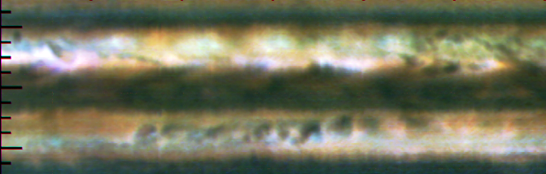
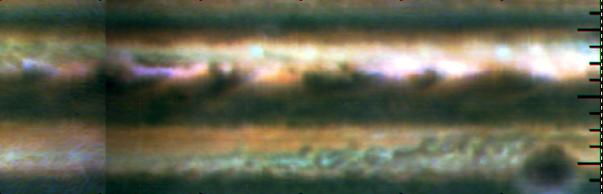
Gemini/TEXES – March 12th-14th 2017
RGB from regions near 1165 cm⁻¹.
Hotspots
PJ4
PJ5
Plumes
SEB Outbreak
Great Red Spot

Slide 9
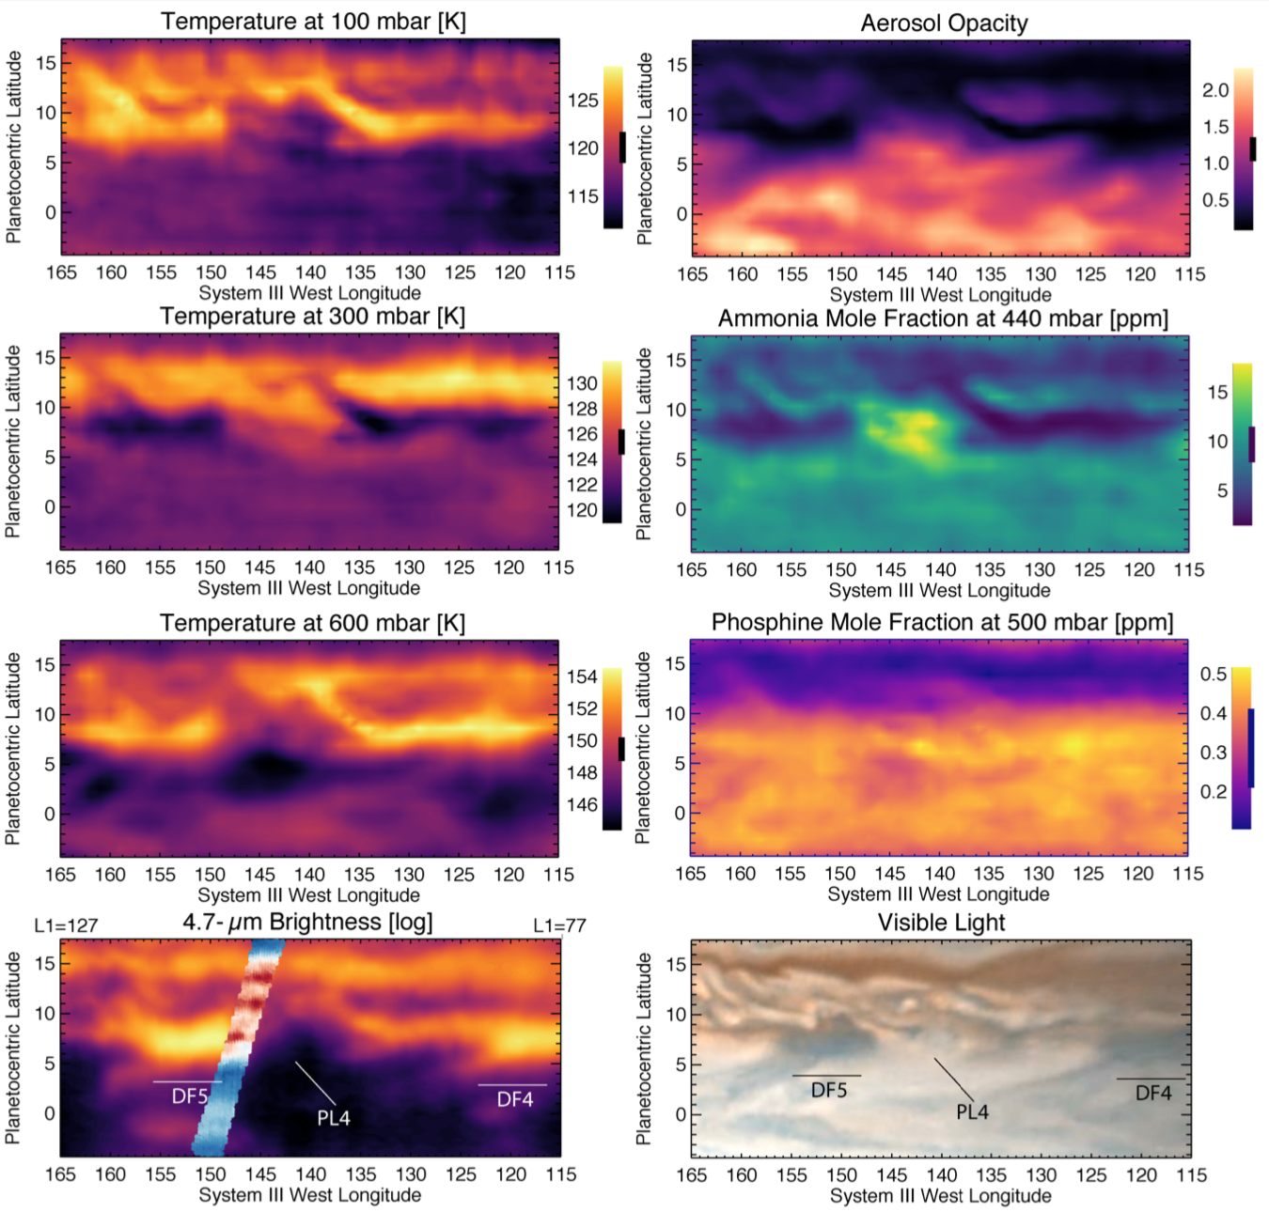
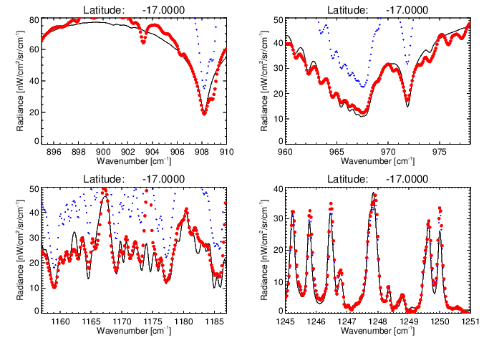
TEXES Inversions
Spectral mapping 7-20 µm from TEXES
NEMESIS retrieval: temperature (1-10 and 80-700 mbar), gases (NH₃, PH₃, C₂H₂, C₂H₆), ~600-mbar aerosols (arXiv:1606.05498)
Seven groups covers whole 25N-25S region, all longitudes.
All examples in arXiv:2004.00072

Slide 10
Conclusions
No two hotspots are equal
NH₃ depletion and T(p) often indistinguishable from rest of NEB at 200-800 mbar.
Aerosol opacity is primary distinguishing variable and not a good proxy for NH₃/T.
Don’t expect MWR to look like JIRAM/JunoCam
No PH₃ variation - shallow?
T/NH₃ varies within a hotspot.
Plumes are cold, cloudy, NH₃-rich:
Conditions vary from plume to plume
Sign of plume “freshness”?
MWR passed 3 hotspots in 2017 (one centre, two edges)
Similar TB to NEB in Ch6.
Indistinguishable from NEB in Ch3.
Hotspots/plumes shallow (p<8-10 bar)
Relevant to MWR – both NH3 and T are varying at p<800 mbar (Ch6)

Slide 11
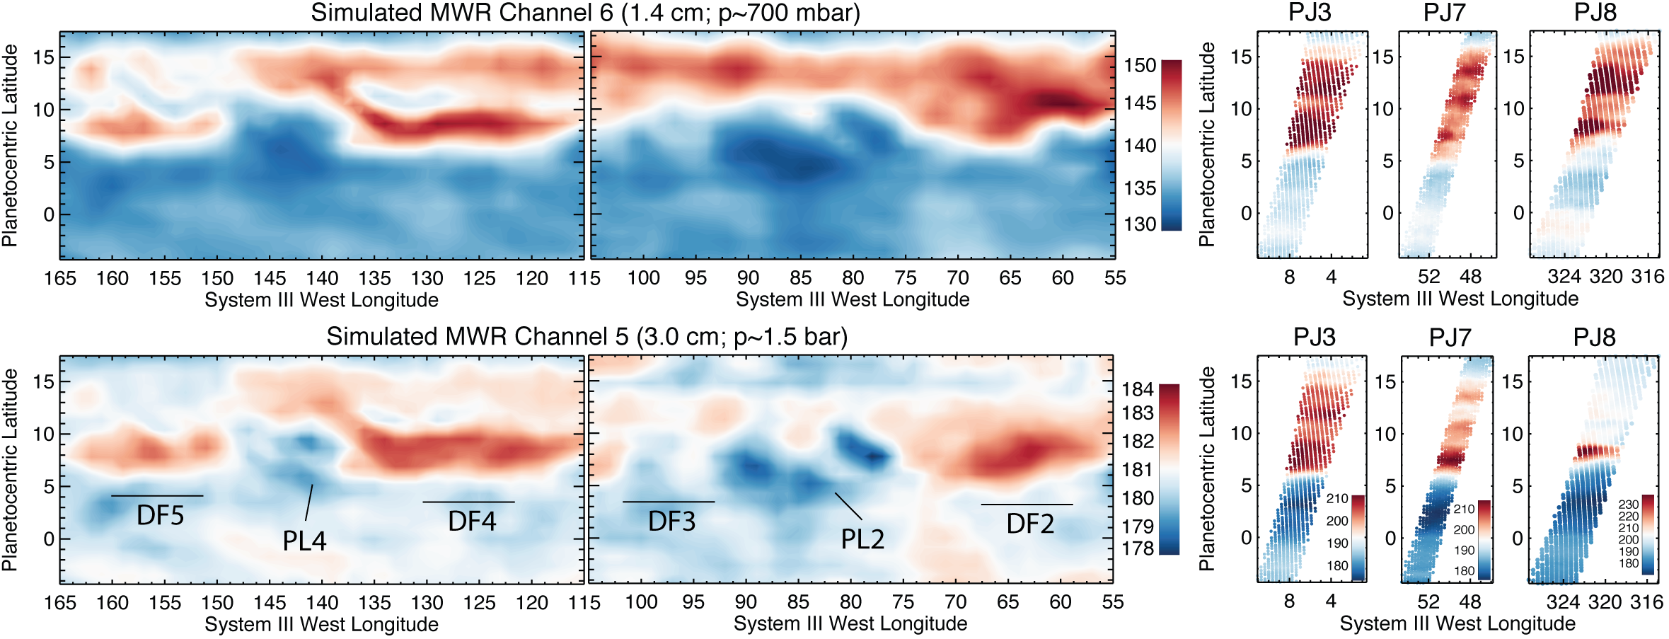
Use TEXES to Simulate MWR
TEXES-MWR consistent for Ch6, not for Ch5 (there’s more NH₃ depletion or warmer T below level of TEXES sensitivity)

Slide 12
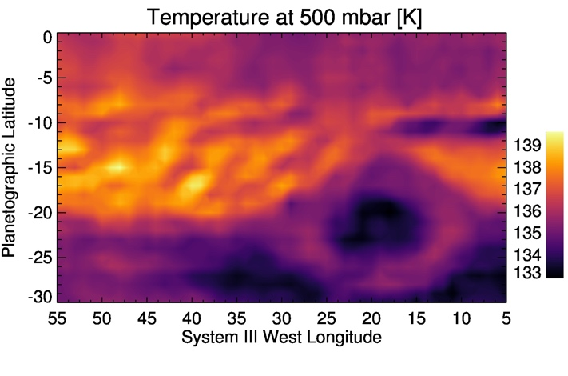
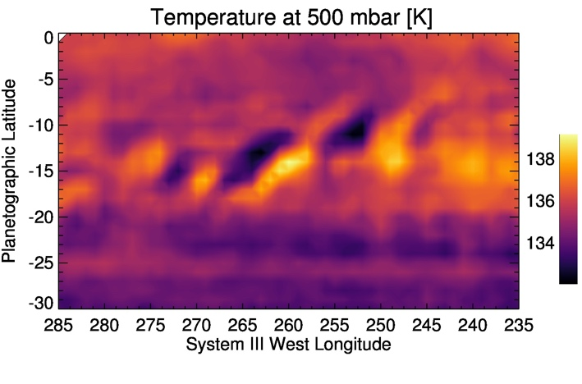
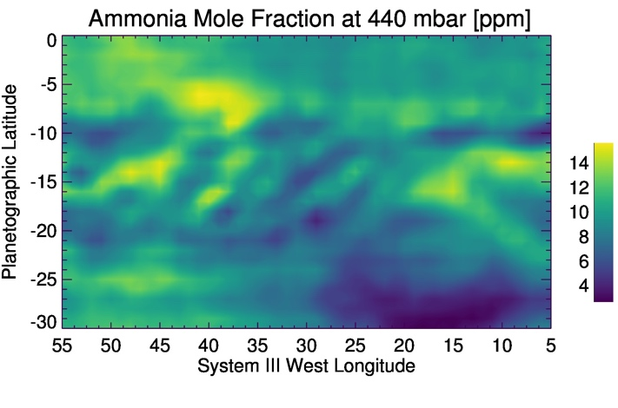
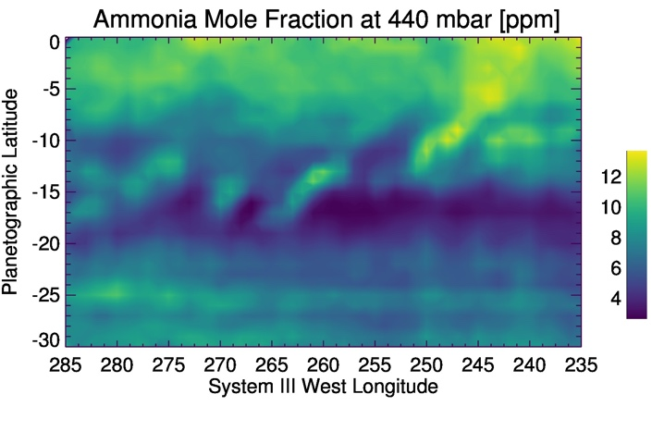
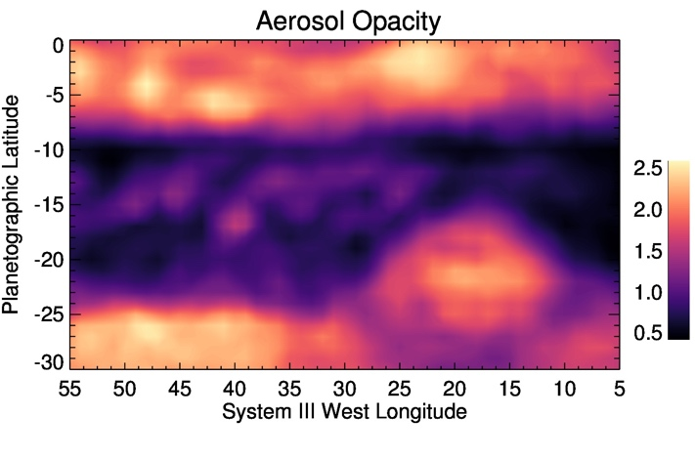
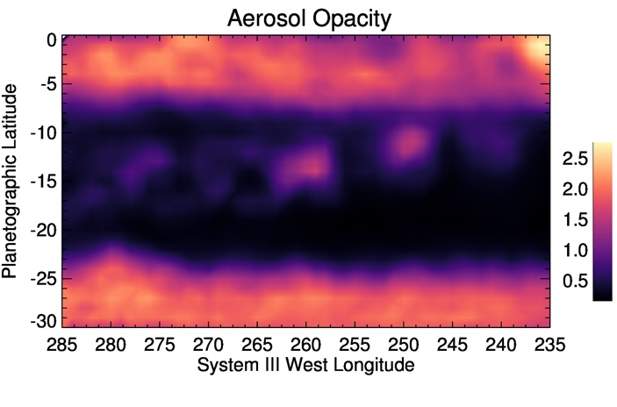
Next Steps
Hotspot 2017 study complete, but needs extending 2018-20.
Additional TEXES coverage of GRS and mid-SEB outbreak (2017).
Joint MWR-thermal inversion:
JAMRT Installation (done)
NH₃/H₂O opacities from Steffes et al. -> NEMESIS (underway)
Cross-comparison of lapse rate calculations (to do)
Forward model intercomparison (to do)
Joint MWR-thermal inversion for consistent NH3/T (goal)
Proposed joint MWR and JWST/MIRI (5-11 µm) study in ~2022.

